Slide 1
Database Systems Development
Lecture 2
Enhanced ER modelling concepts

Slide 2
Agenda
Relationships with attributes
Recursive relationships
Relationships with degree higher then 2
Specialization/generalization EER concepts
Aggregation and composition
Alternative notations

Slide 3
Revision
Type
Strong
Entity
Weak
Occurrence
Type
Degree
Relationship
Occurrence
Multiplicity
Cardinality
Participation
Single valued
Complex
Attribute
Multi valued
Simple

Slide 4
Recursive relationships
Recursive Relationship
  Relationship type where same entity type participates more than once in different roles.
Relationships may be given role names to indicate purpose that each participating entity type plays in a relationship.

Slide 5
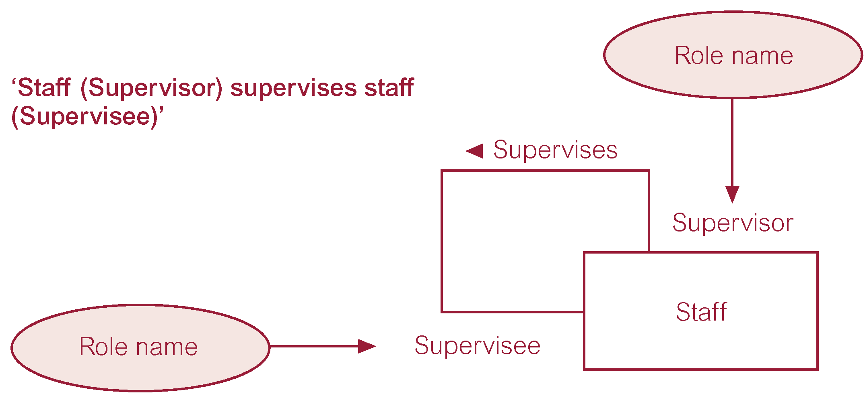
Recursive relationships

Slide 6
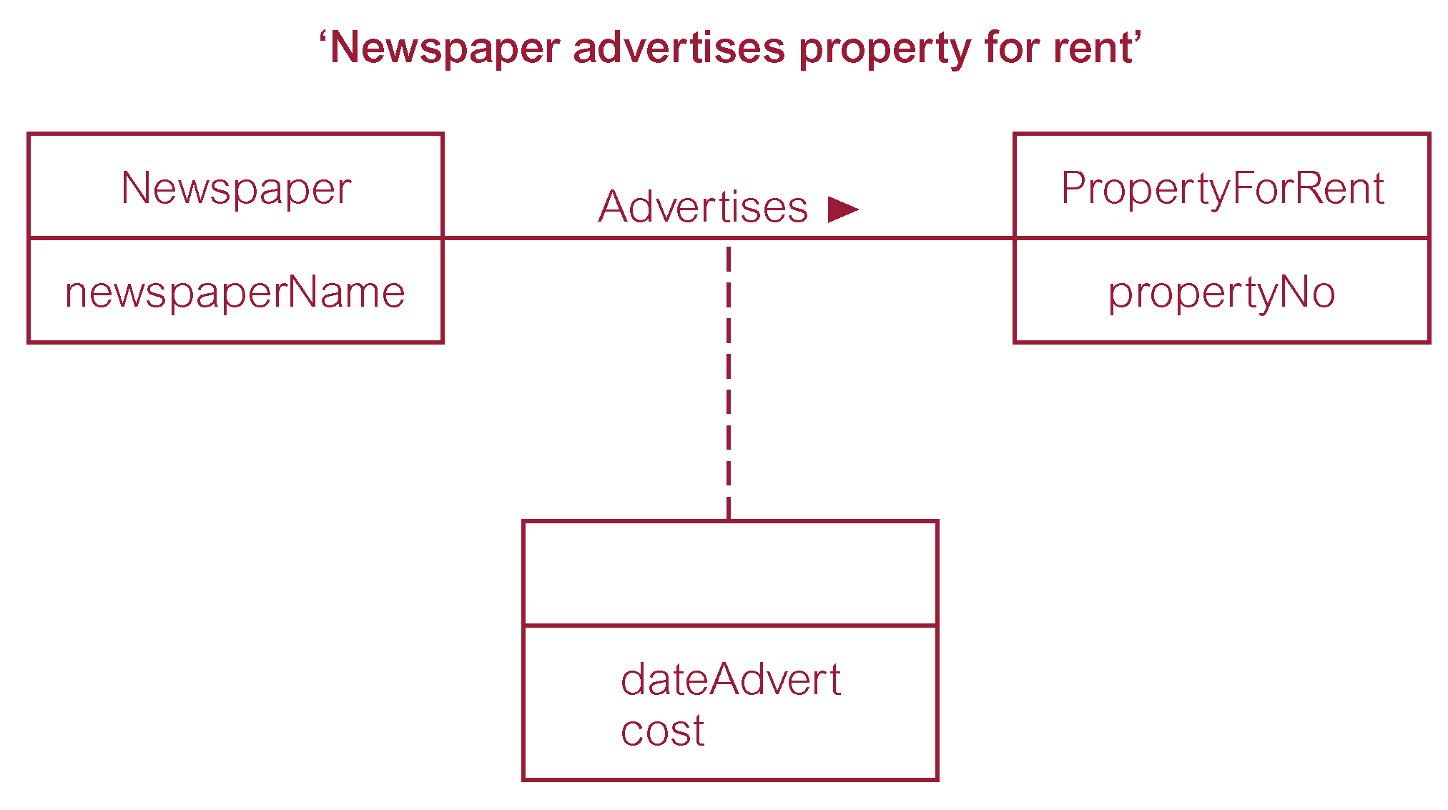
Relationship attributes

Slide 7
N-ary relationships
Degree of a Relationship
  Number of participating entities in relationship.
Relationship of degree:
  two is binary;
  three is ternary;
  four is quaternary.

Slide 8
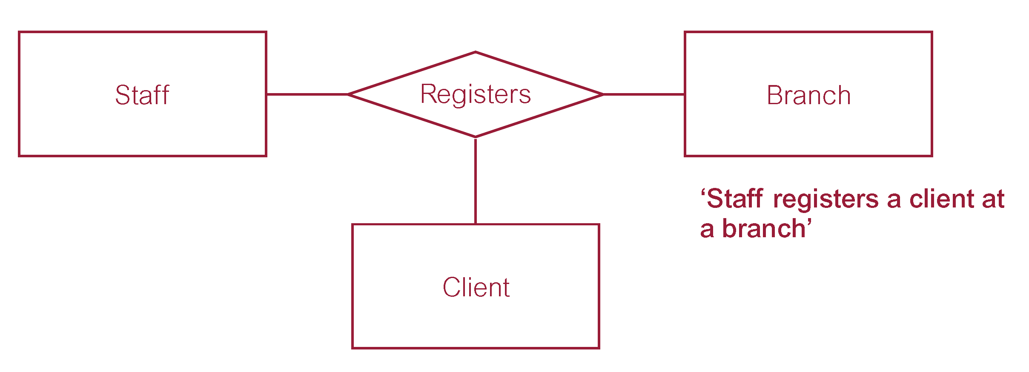
N-ary relationships – ternary

Slide 9
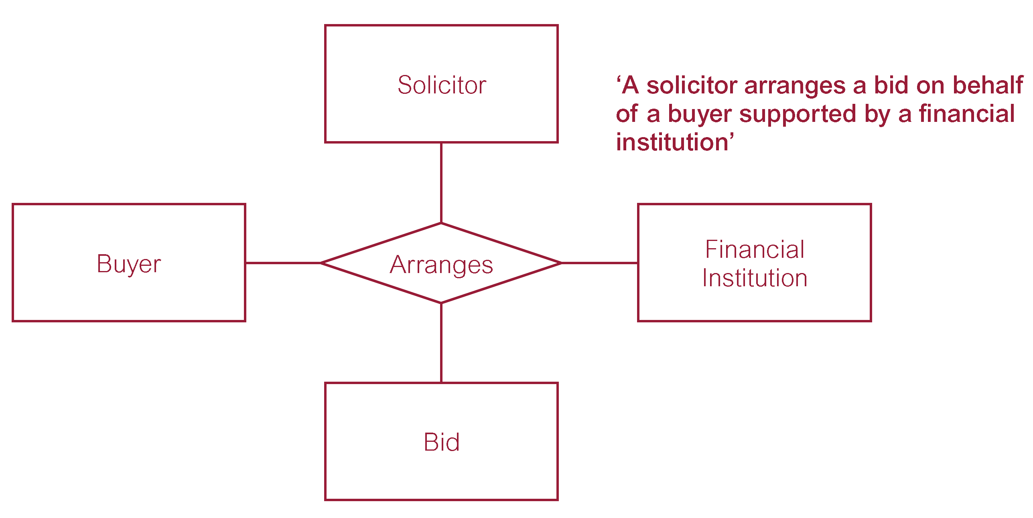
N-ary relationships – quaternary

Slide 10
N-ary relationships - multiplicity
Multiplicity for Complex Relationships
  Number (or range) of possible occurrences of an entity type in an n-ary relationship when other (n-1) values are fixed.

Slide 11
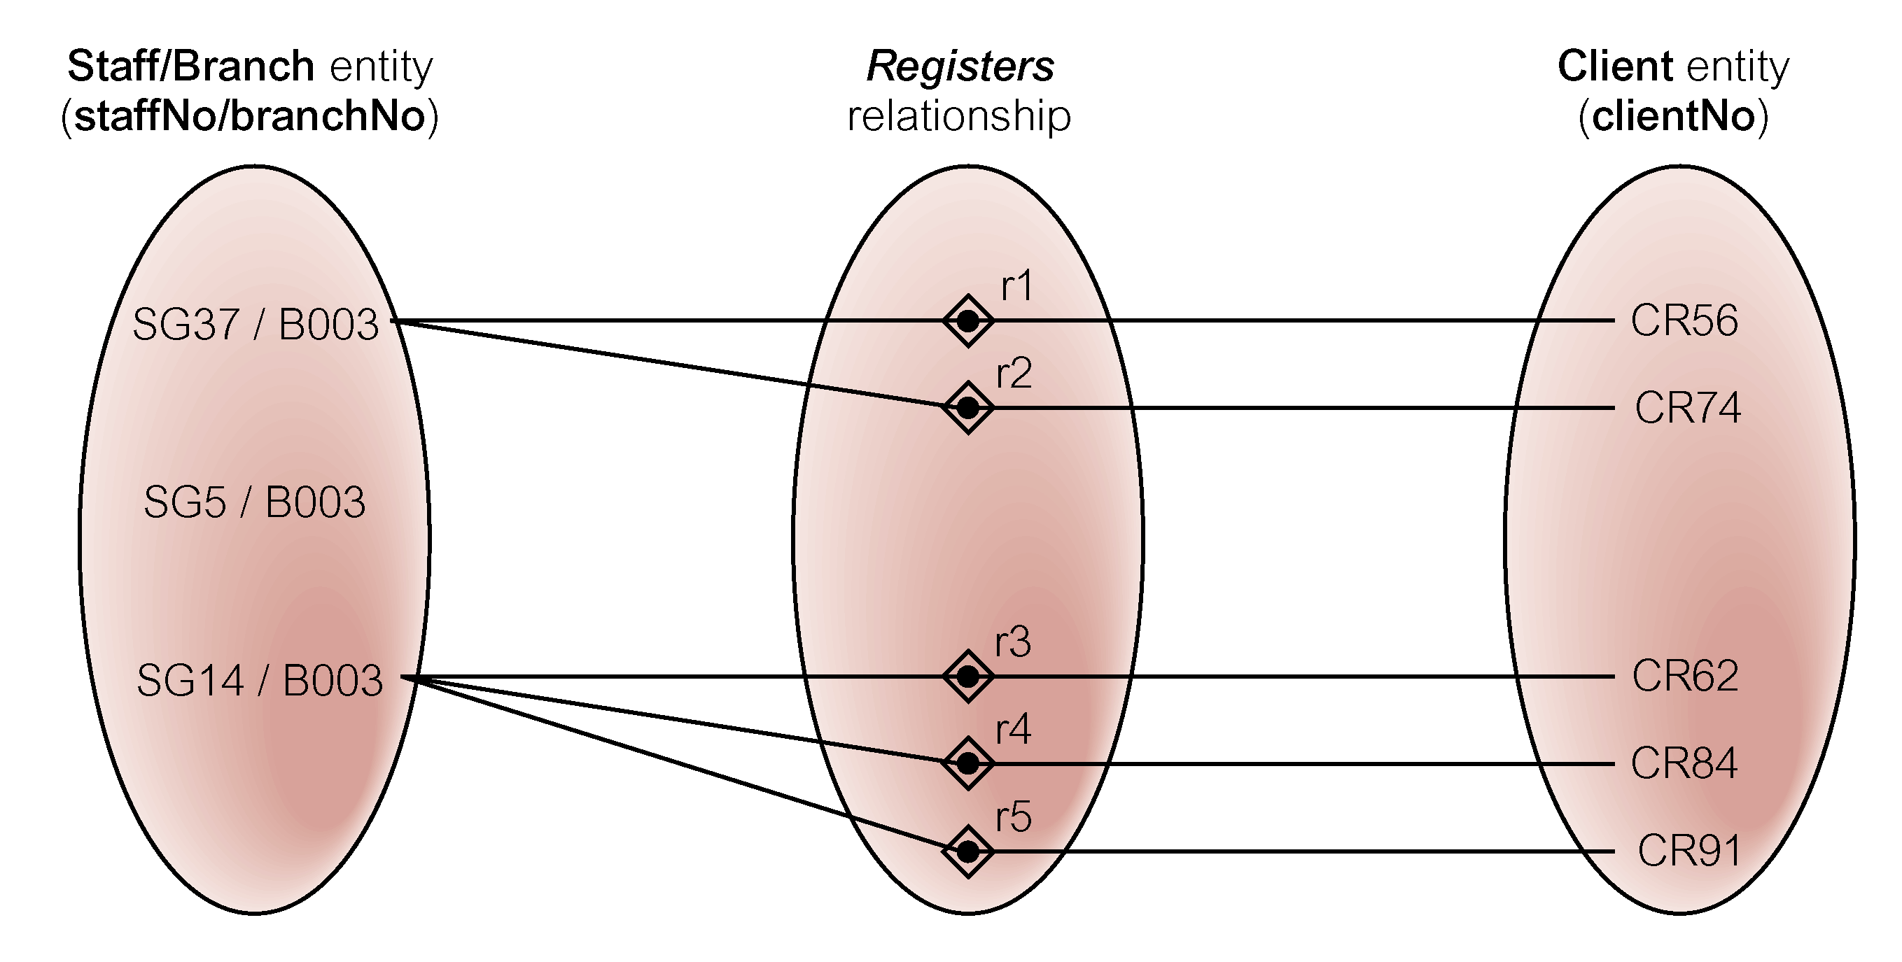
N-ary relationships – multiplicity
Ternary relationship called ‘Registers’ with Values for Staff and Branch entities fixed

Slide 12
N-ary relationships – multiplicity
Try to detect multiplicities for remaining participating entities in ternary relationship Registers
Note: You can make appropriate assumptions and detect multiplicities accordingly

Slide 13
Enhanced Entity-Relationship Model
Semantic concepts are incorporated into the original ER model and called the Enhanced Entity-Relationship (EER) model.
Examples of additional concepts of EER model are:
  specialization/generalization (subclass/superclass);
  aggregation;
  composition.

Slide 14
EER - Specialisation/Generalisation
Superclass
  An entity type that includes one or more distinct subgroupings of its occurrences.
Subclass
  A distinct subgrouping of occurrences of an entity type.

Slide 15
EER - Specialisation/Generalisation
Superclass/subclass relationship is one-to-one (1:1).
Superclass may contain overlapping or distinct subclasses.
Not all members of a superclass need to be a member of a subclass.

Slide 16
EER - Specialisation/Generalisation
Attribute Inheritance
  An entity in a subclass represents same ‘real world’ object as in superclass, and may possess subclass-specific attributes, as well as those associated with the superclass.

Slide 17
EER - Specialisation/Generalisation
Specialization
  Process of maximizing differences between members of an entity by identifying their distinguishing characteristics.
Generalization
  Process of minimizing differences between entities by identifying their common characteristics.

Slide 18
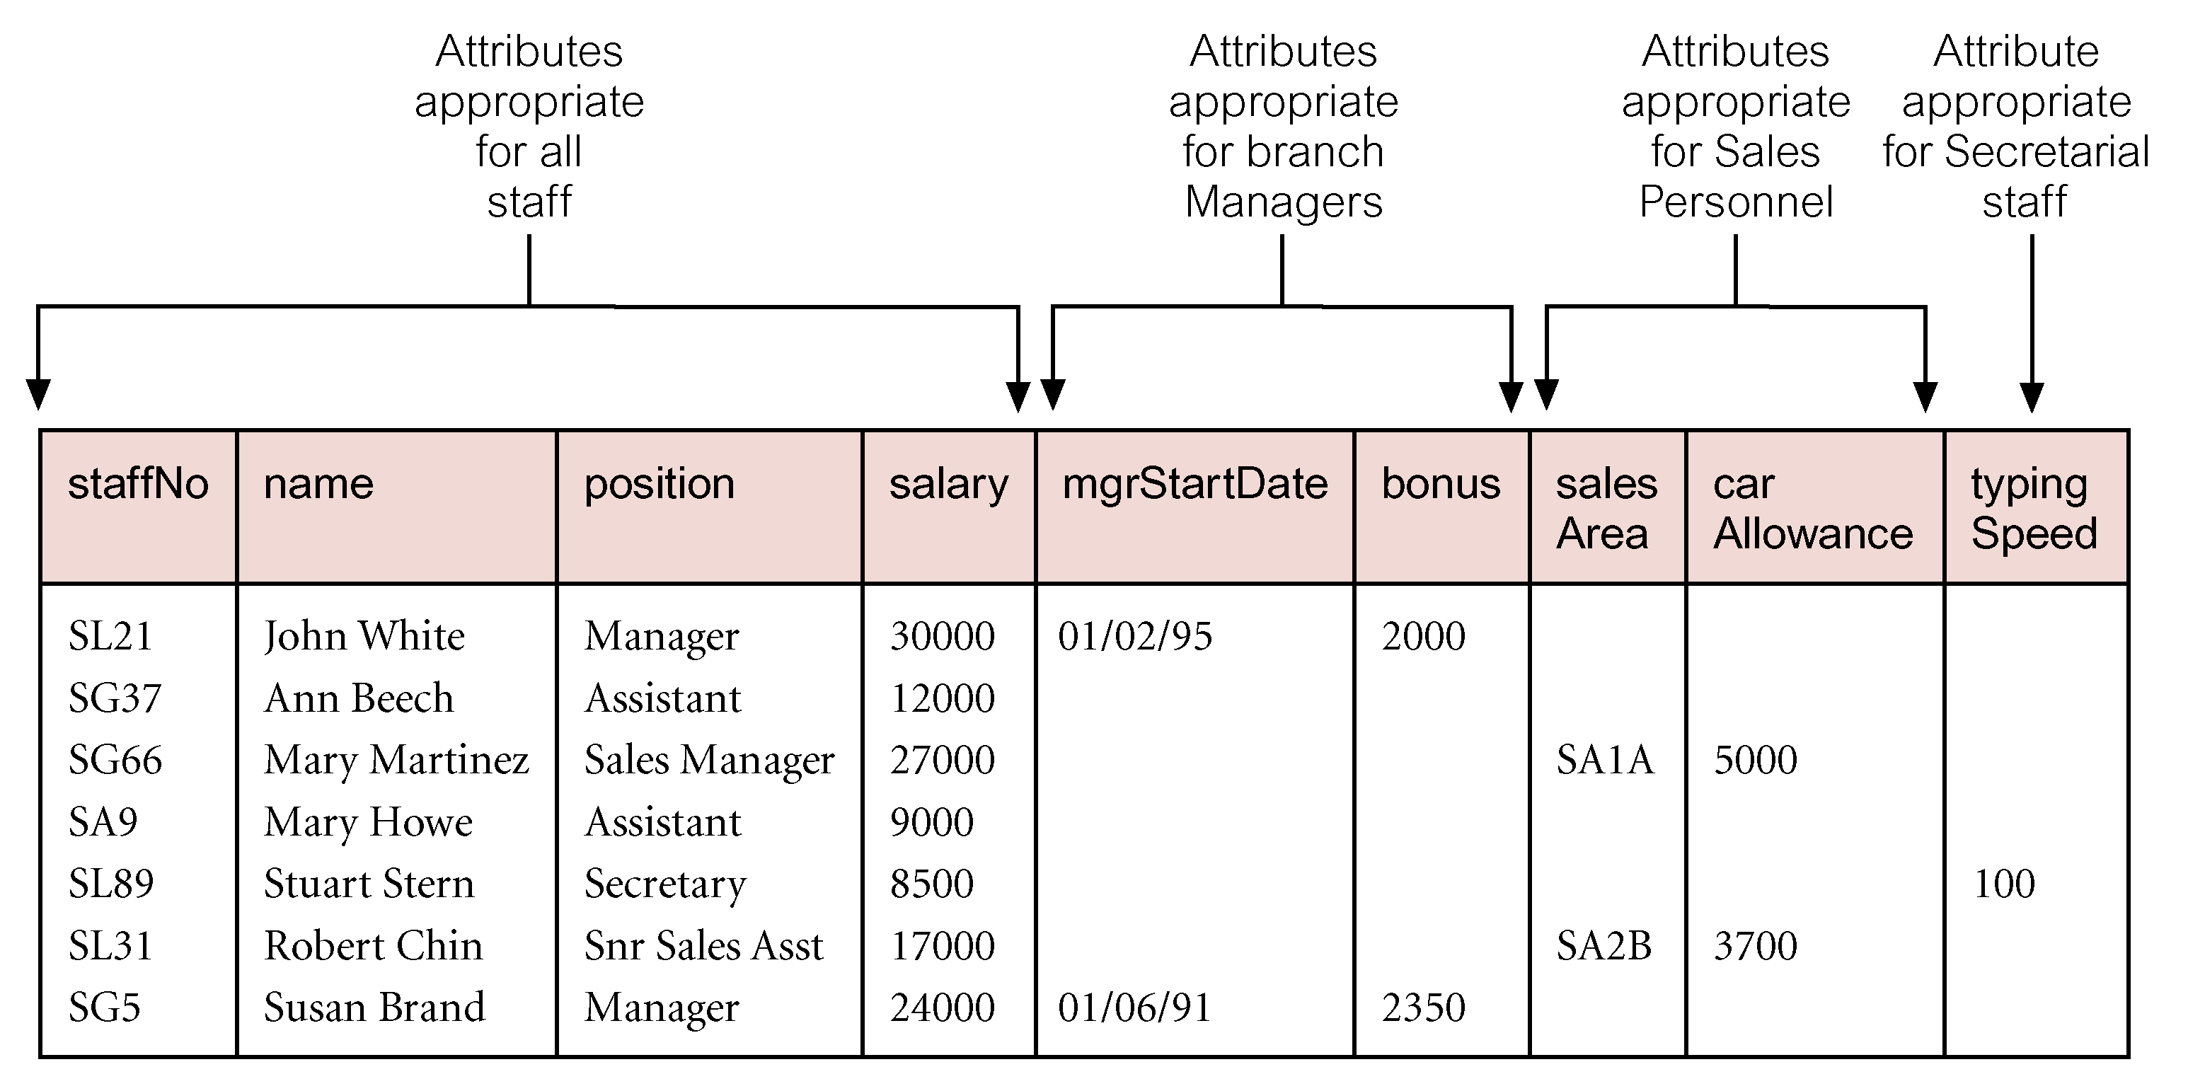
EER - Specialisation/Generalisation

Slide 19
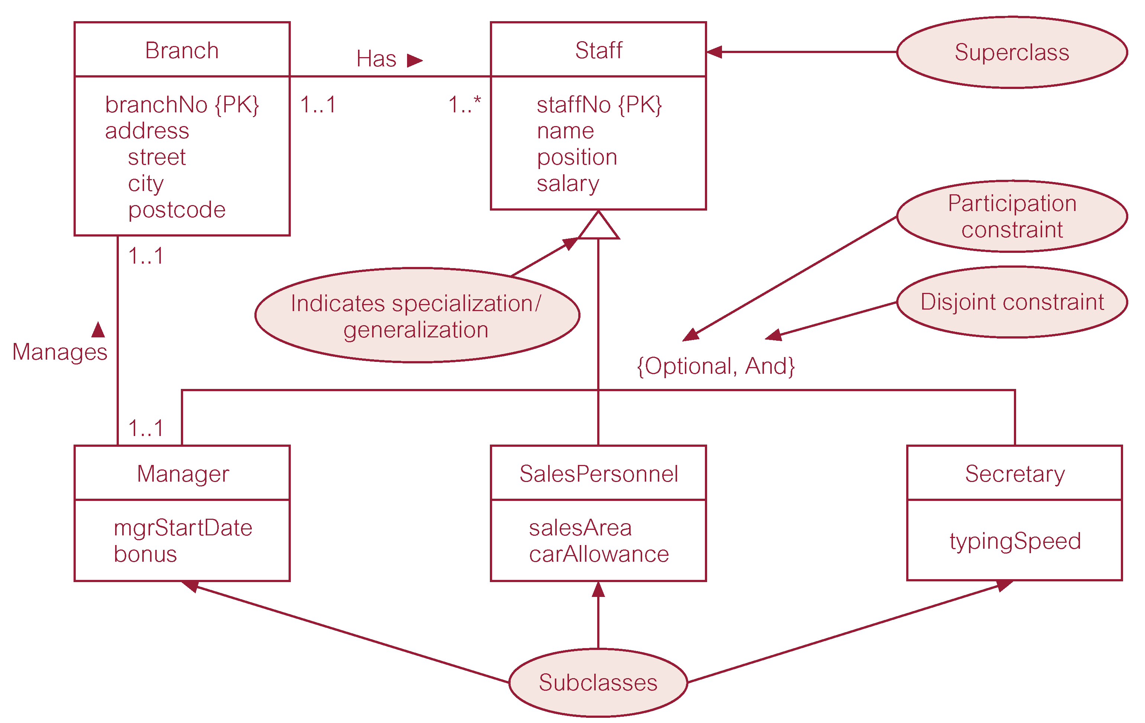
EER - Specialisation/Generalisation

Slide 20
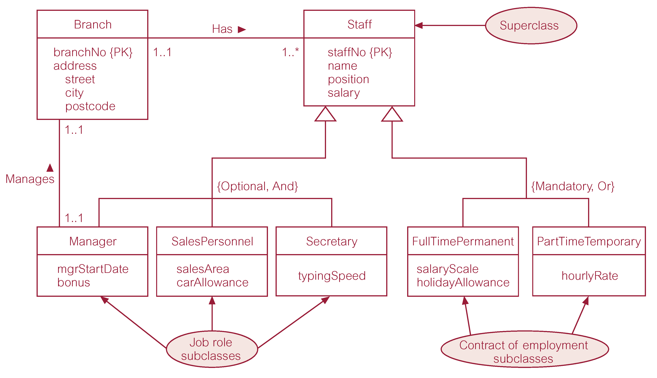
EER - Specialisation/Generalisation

Slide 21
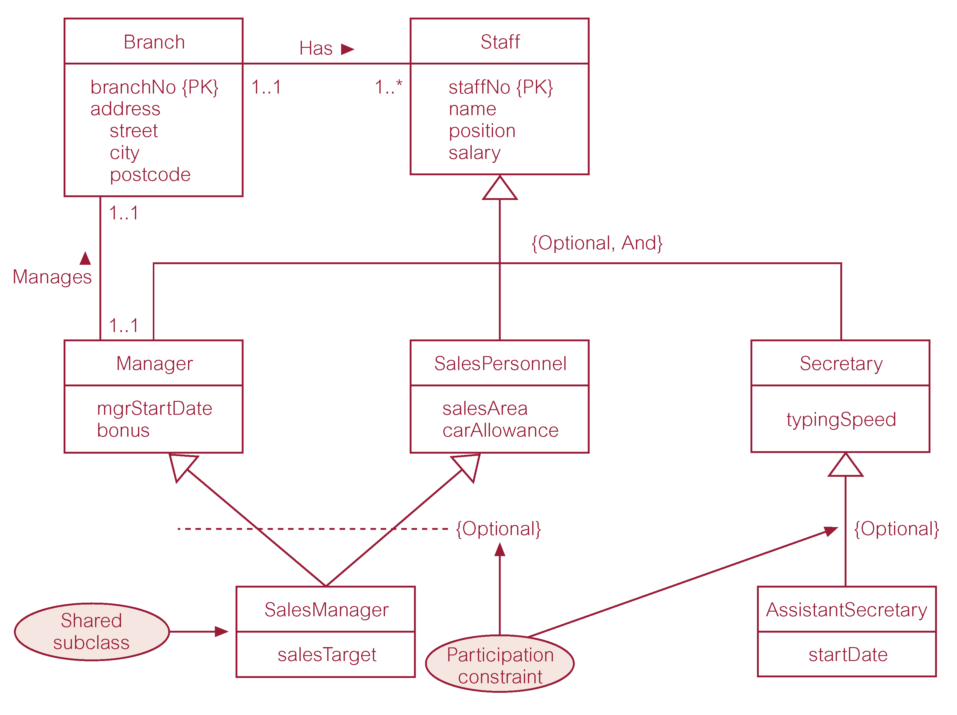
EER - Specialisation/Generalisation

Slide 22
Specialisation/Generalisation - constraints
Participation constraint
  Determines whether every member in superclass must participate as a member of a subclass.
  May be mandatory (total) or optional.
Disjointness constraint
  Describes relationship between members of the subclasses and indicates whether member of a superclass can be a member of one, or more than one, subclass.
  May be disjoint (OR) or overlapping (AND)

Slide 23
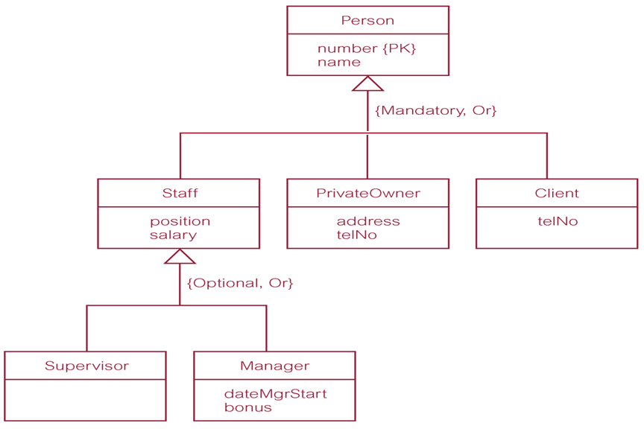
Specialisation/Generalisation - constraints

Slide 24
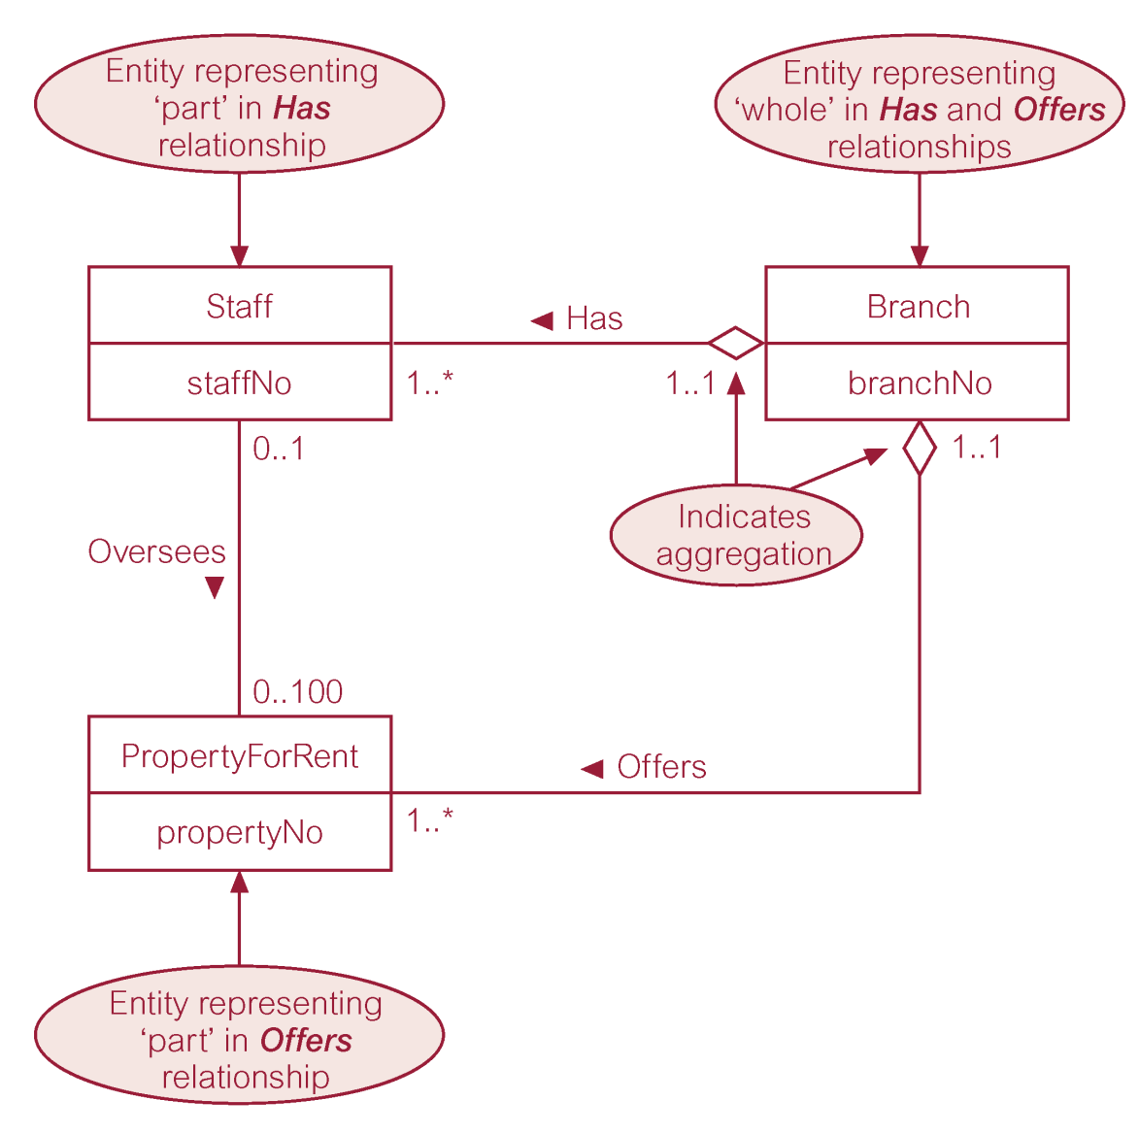
EER - Aggregation
Represents a ‘has-a’ or ‘is-part-of’ relationship between entity types, where one represents the ‘whole’ and the other ‘the part’.

Slide 25
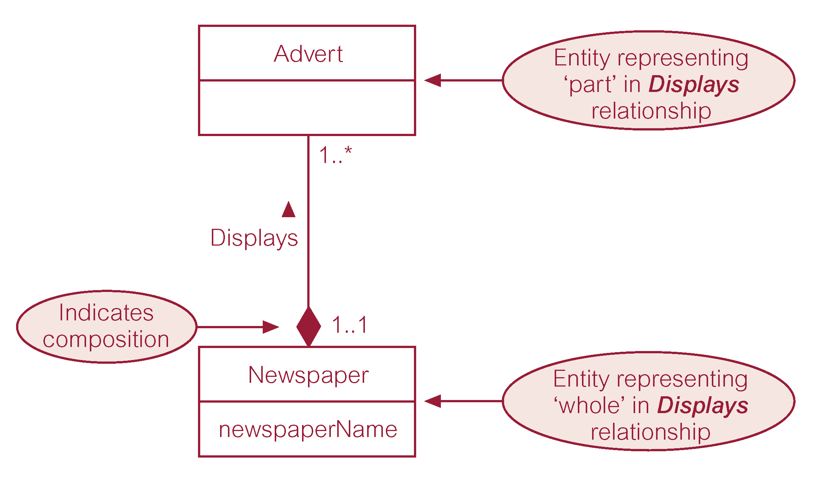
EER - Composition
Specific form of aggregation that represents an association between entities, where there is a strong ownership and coincidental lifetime between the ‘whole’ and the ‘part’.

Slide 26
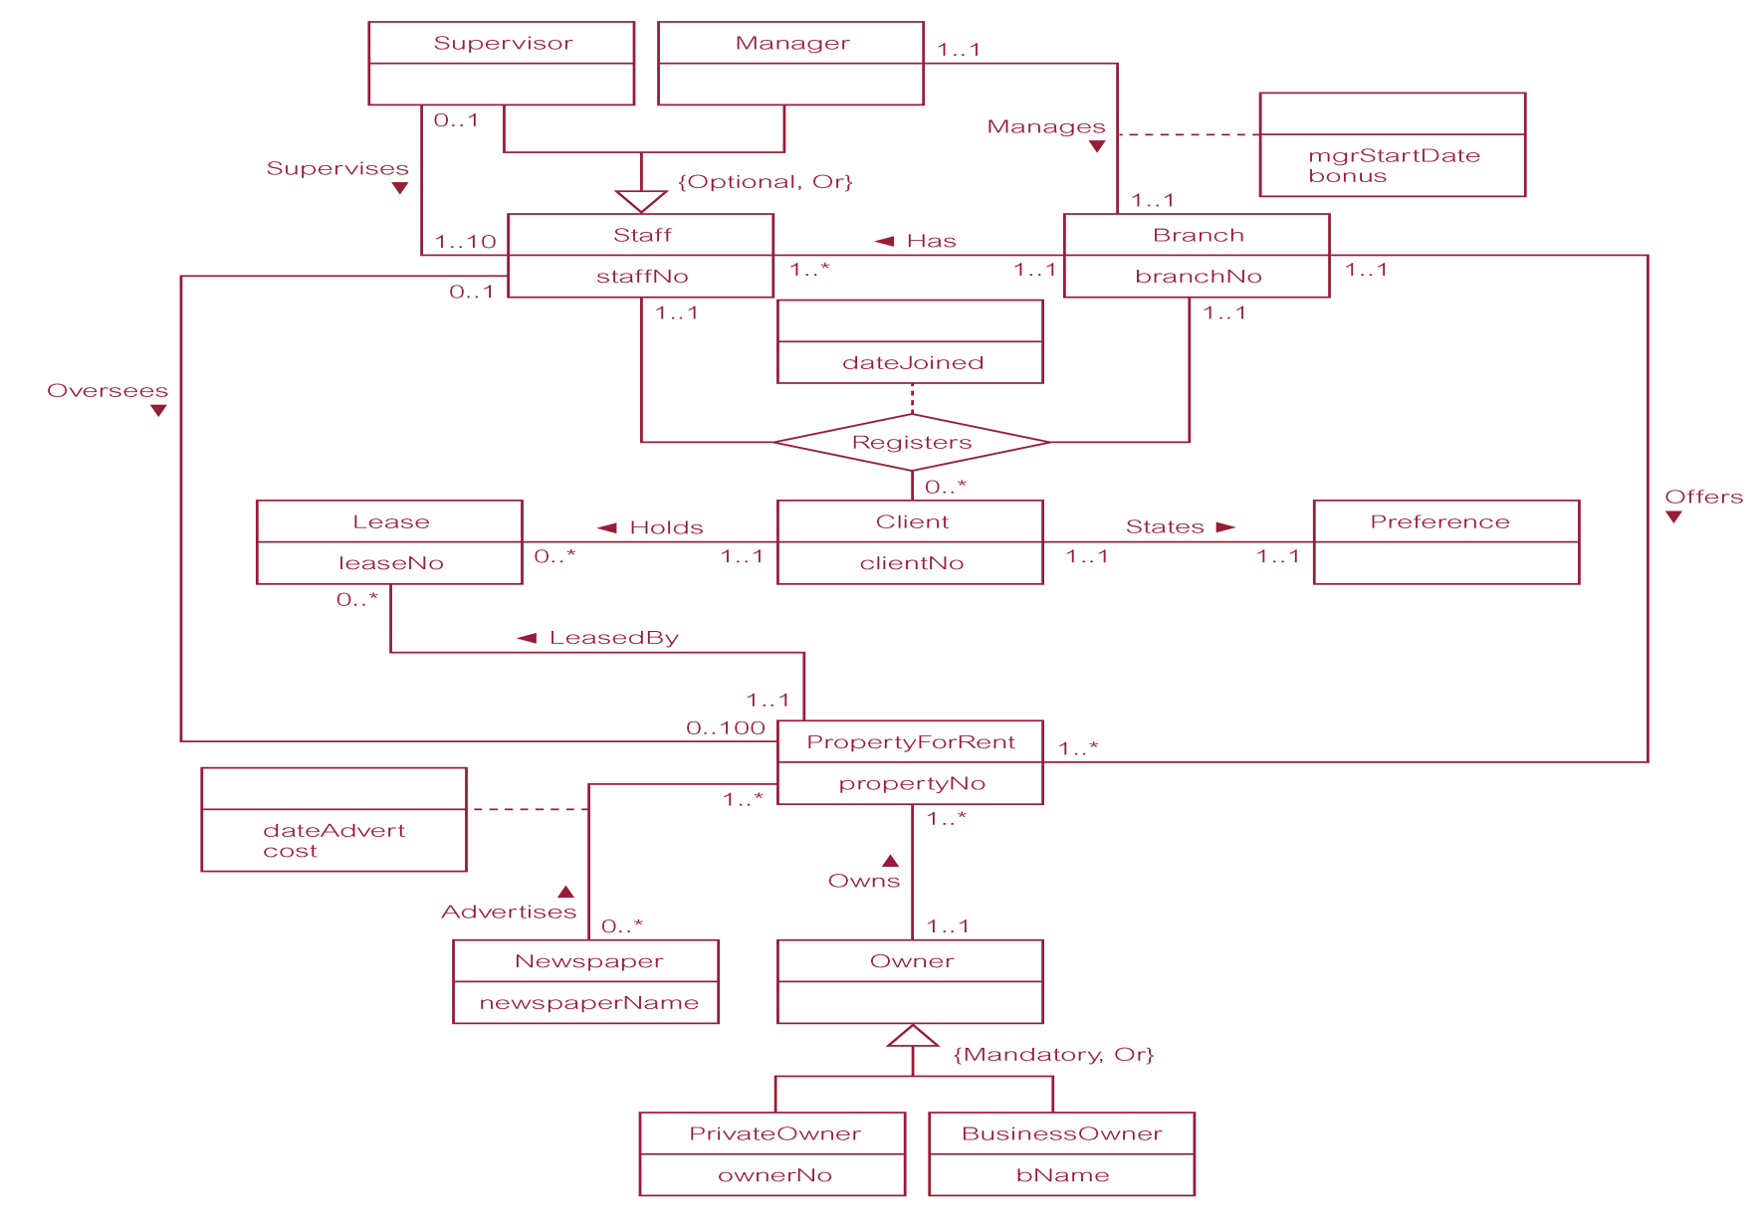
EER – diagram example

Slide 27
Alternative notations: Chen’s notation
Symbol
Meaning
ENTITY TYPE
WEAK ENTITY TYPE
RELATIONSHIP TYPE
IDENTIFYING RELATIONSHIP TYPE
ATTRIBUTE
KEY ATTRIBUTE
MULTIVALUED ATTRIBUTE
COMPOSITE ATTRIBUTE
DERIVED ATTRIBUTE
TOTAL PARTICIPATION OF E₂ IN R
CARDINALITY RATIO 1:N FOR E₁:E₂ IN R
STRUCTURAL CONSTRAINT (min, max) ON PARTICIPATION OF E IN R
E₁
R
E₂
E₁
R
N
E₂
(min,max)
R
E

Slide 28
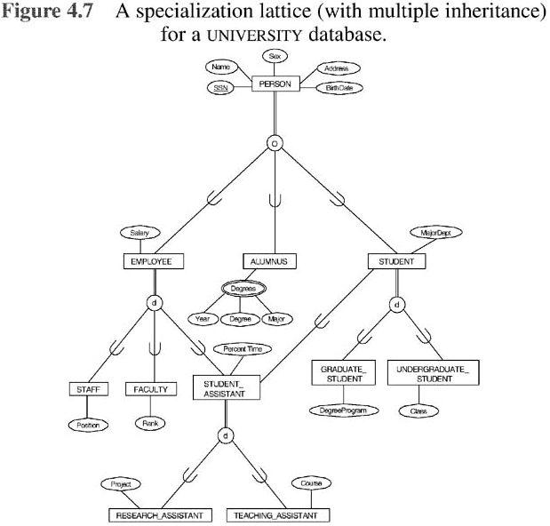
Chen’s notation - example

Slide 29
Other notations
Crow's foot notation http://www2.cs.uregina.ca/~bernatja/crowsfoot.html
Barker's notation http://ece.uprm.edu/~icom5047/documents/barkers-erd-notation.pdf
IDEF1X https://ru.qwe.wiki/wiki/IDEF1X

Slide 30
Reading
T. Connoly Chapter 13
N. Elmasri Chapter 5

